Slide 1
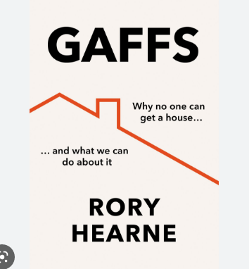
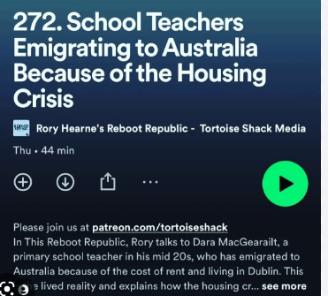
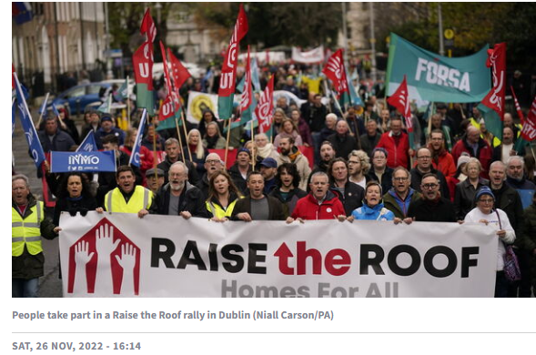
From property to home: housing as a place of belonging, a human right
Dr Rory Hearne, Lecturer Department of Applied Social Studies Maynooth University, author, podcaster, campaigner

Slide 2
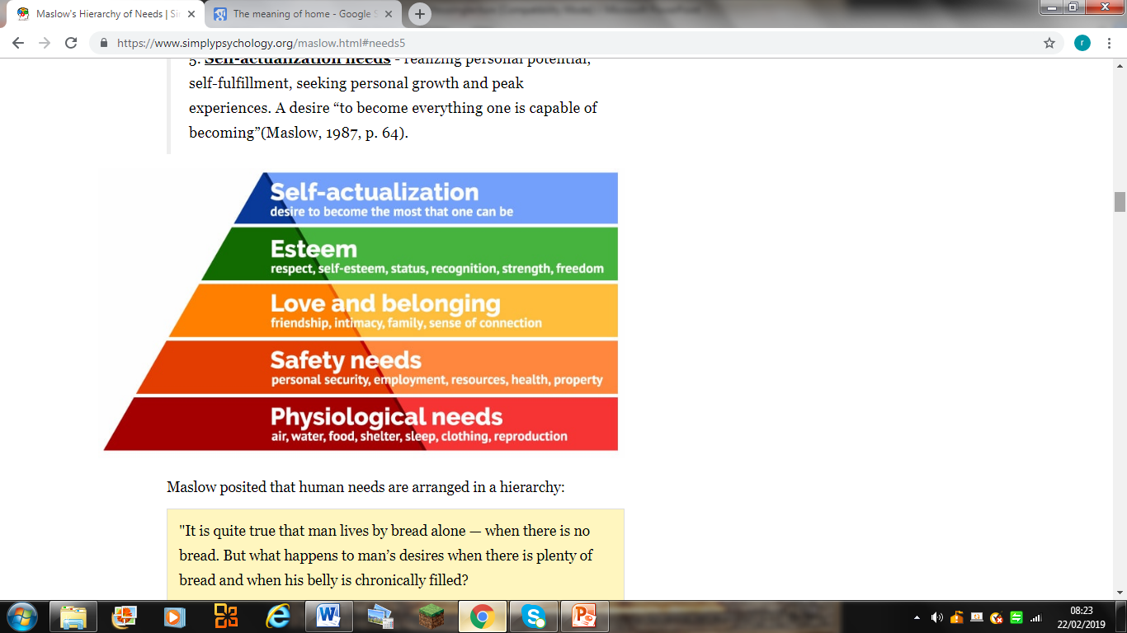
Home as sanctuary - the psychosocial role of home (social determinants of health): a secure base, safety belonging, roots
Housing is required not just to meet shelter needs, but all human needs across the five levels of Maslow’s hierarchy.
A social policy, psychological and health approach to housing - the “psychosocial” importance of home – its impact on our psychological well-being, on our physical and mental health.
Home as sanctuary- as physical and psychological safety (and the impact when it doesn’t provide that
By providing a secure base, housing provides a deep sense of psychological safety and stability, known as ‘ontological’ security
Ontological security is fundamental to our sense of ourselves, our self-identity, and our feelings of security about the reliability of life.
A secure sense of belonging and attachment to a place, a home, is necessary for wellbeing
Homelessness, insecure housing, impacts on our self-identity, and our mental health. This can lead to feelings of shame, stigma, and status anxiety.

Slide 3
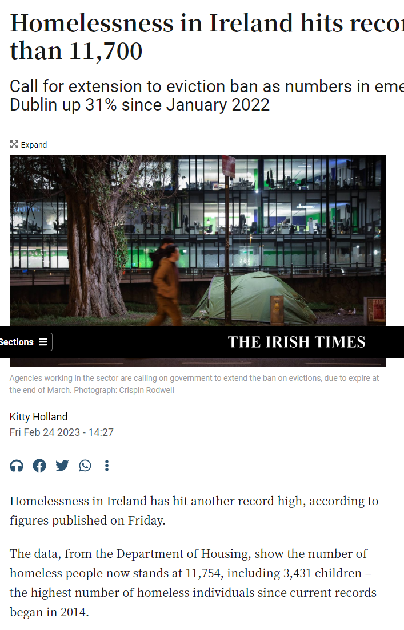
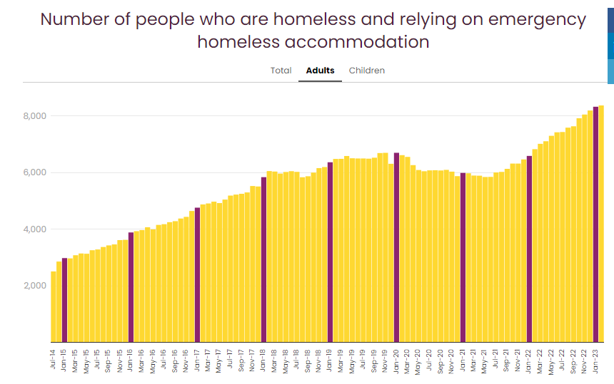
Ireland’s housing disaster – an economic and social catastrophe

Slide 4
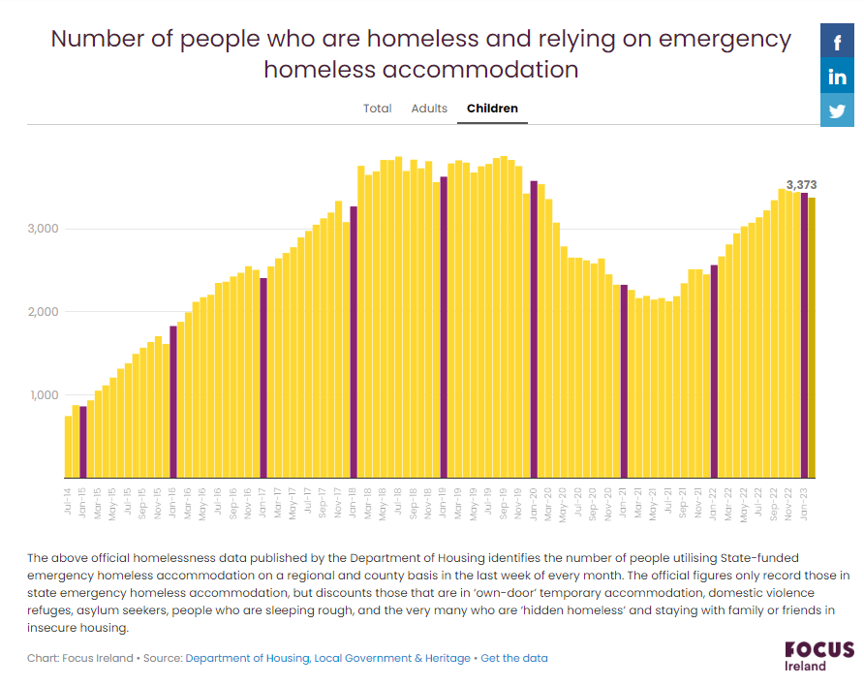
Almost a decade of ‘new’ type of homelessness: children & families being made homeless

Slide 5
Emergence of ‘Generation Rent’ –doubling in households living in private rental sector
The country has experienced a dramatic rise in the proportion of households in the private rental housing sector
Almost doubling from 11% in 2002 (approximately 150,000 households)
to 19% of households (300,000) in 2011
Collapse in homeownership, rise in ‘Generation Stuck at Home’ & emigration

Slide 6
Home ownership collapse –longer term social time bomb
Ireland has experienced a marked drop in homeownership rates in recent years.
The share of 25-34 year olds who own their own home more than halving between 2004 and 2019, falling from 60 per cent to just 27 per cent.
Approximately just 50% likely to become homeowners
Lower rates of homeownership are likely to lead to substantially higher income poverty rates after-housing costs (AHC) in retirement
Could raise the proportion of older people (aged 65+) living in income poverty on an after-housing cost (AHC) basis, from 14 per cent at present, to as high as 31 per cent

Slide 7
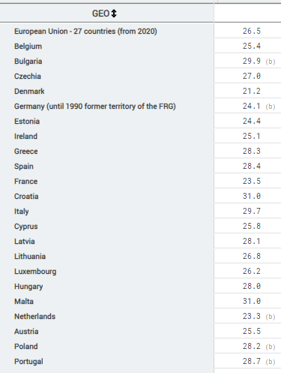
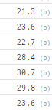
Hidden housing crisis of Generation ‘stuck at home’ – hidden homelessness
Estimated average age of young people leaving the parental home (Eurostat
ADD MAP!)
Denmark 21
Germany 23.6
Greece 28 to 30
Biggest increase:
Ireland 25 to 28.4

Slide 8
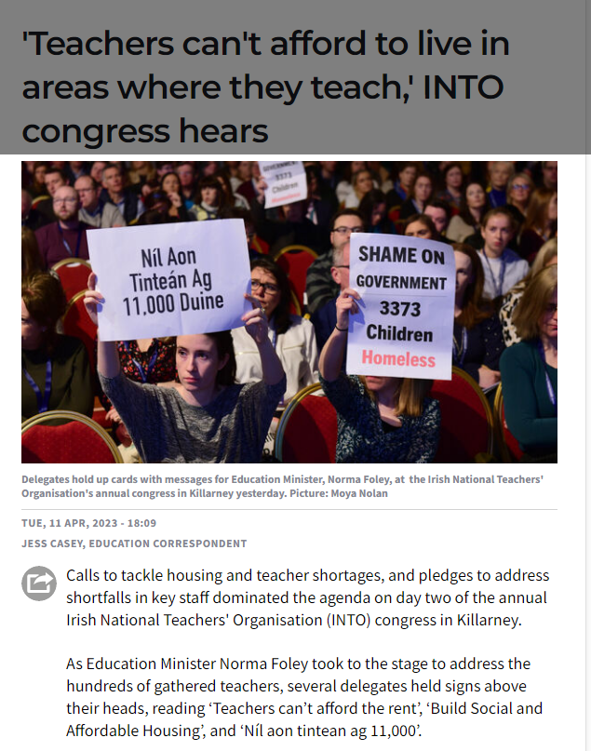
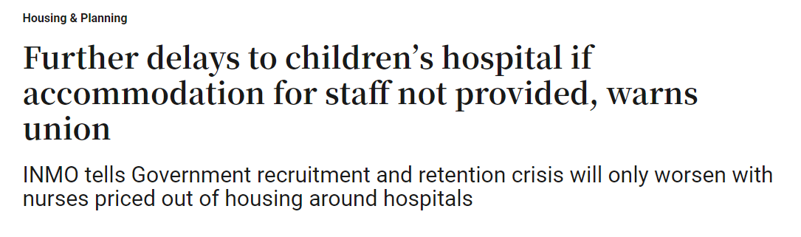
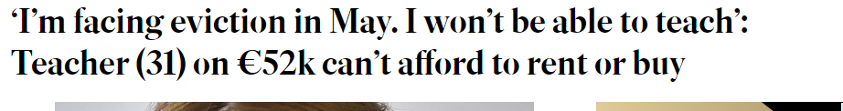
Economic impact –key workers cant afford to live in Dublin & other Irish cities

Slide 9

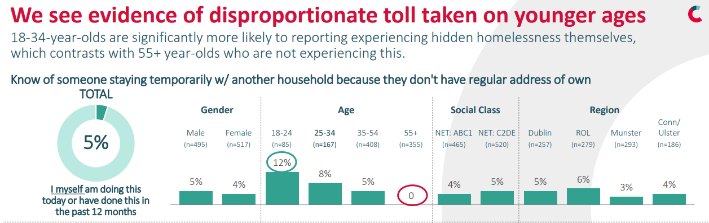

Slide 10
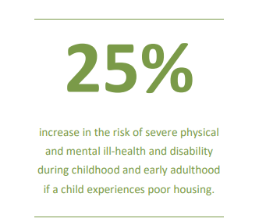
Housing insecurity, hidden homelessness & home loss is a psychological trauma with physical & mental health impacts
In Dublin almost 4000 families (8000 children) presented as homeless in last 2.5 years
The seriousness of the impact of the experience of homelessness on a child’s life can be appreciated when viewed through the lens of the trauma-informed theory of adverse childhood experiences (ACEs).
Trauma from the loss of aspects of home – the physical space of familiarity, of childhood possessions, memories, friends, community
A child who has experienced homelessness is significantly more likely to experience negative outcomes in adulthood, including mental health difficulties, unemployment, substance abuse

Slide 11
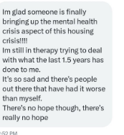
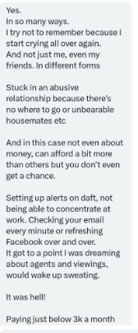
Pscyhosocial impact of the housing crisis – mental and physical ill health

Slide 12
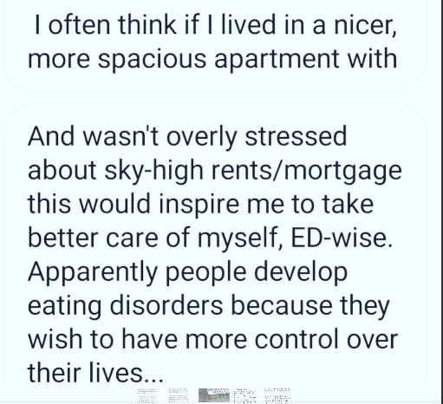
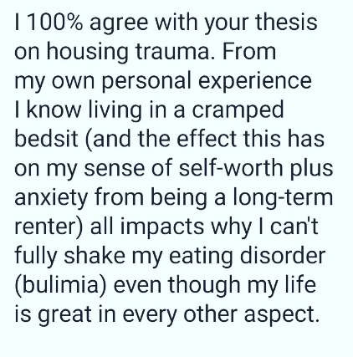

Slide 13
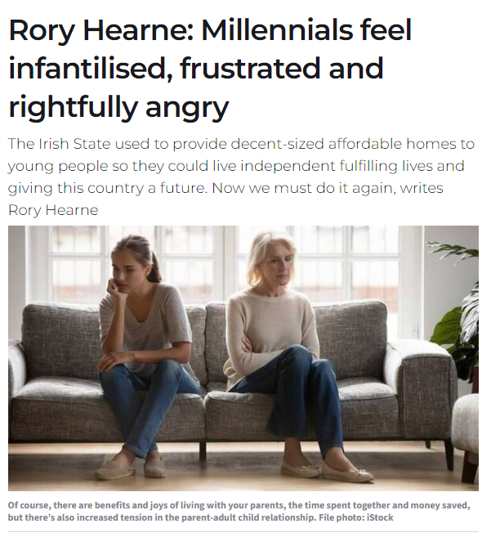
A home is about autonomy
A home is a place where you have the freedom to change furniture, paint the walls as you like, not have to ask permission to have a pet, as if you were a child, and be able to invite friends or whoever you want over to your home. As a renter explained,
“For me home means freedom - to own a pet, to hang up a painting, to repaint the walls or change the wallpaper. But also freedom to listen to whatever music I like, to wear pyjamas all day, to cook anything I want without negotiating with a roommate or parents”.

Slide 14
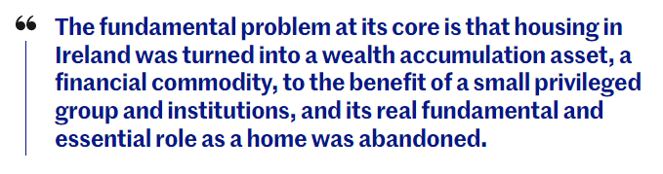
So what are the causes of the Irish housing crisis? Shift from treating housing as home to ‘financial asset’ –from state to market
Ideology & policy shift to neoliberalism by successive Governments –retreat of state from direct building of social housing from 1990s on-wards –shift to the market as main provider of housing
Wave/phase 1 of financialisation – commodification of housing in 2000s (mortgage & BTL lending)
Wave/phase 2 of financialisation –Post GFC - austerity cuts to social housing, vulture fund purchase of distressed assets & loans
Wave/phase 3 of financialisation –2013+ : turning Generation Rent (& social housing) into an asset for small landlords & formation of new corporate investor landlord in Ireland (Cuckoo & Vampire funds) – ‘Build-to-rent’
Phase 4 2022: Crisis for Irish politics of/& financialisation: a possibility of de-financialisation?

Slide 15
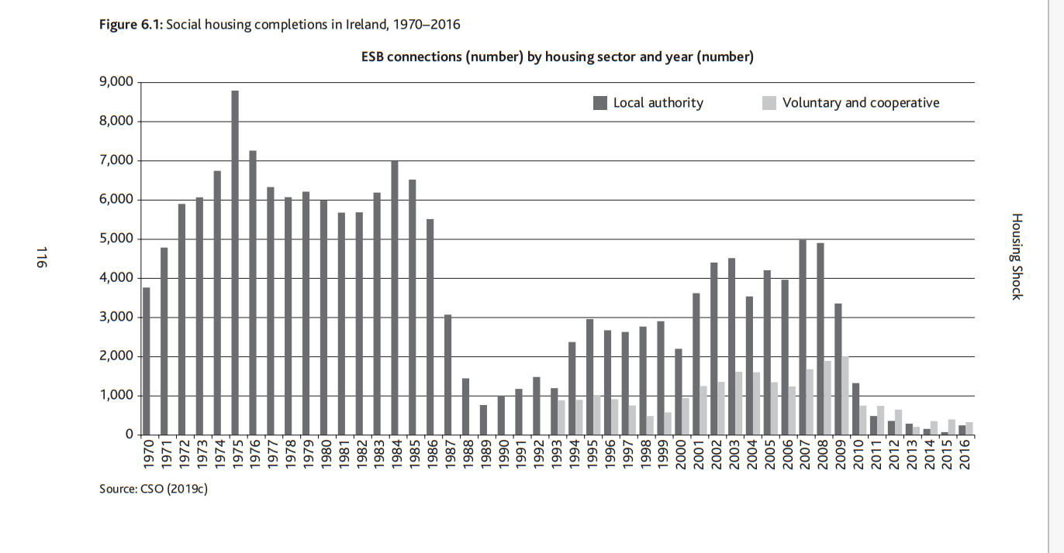
Neoliberalism & phase 1 of Financialisation

Slide 16
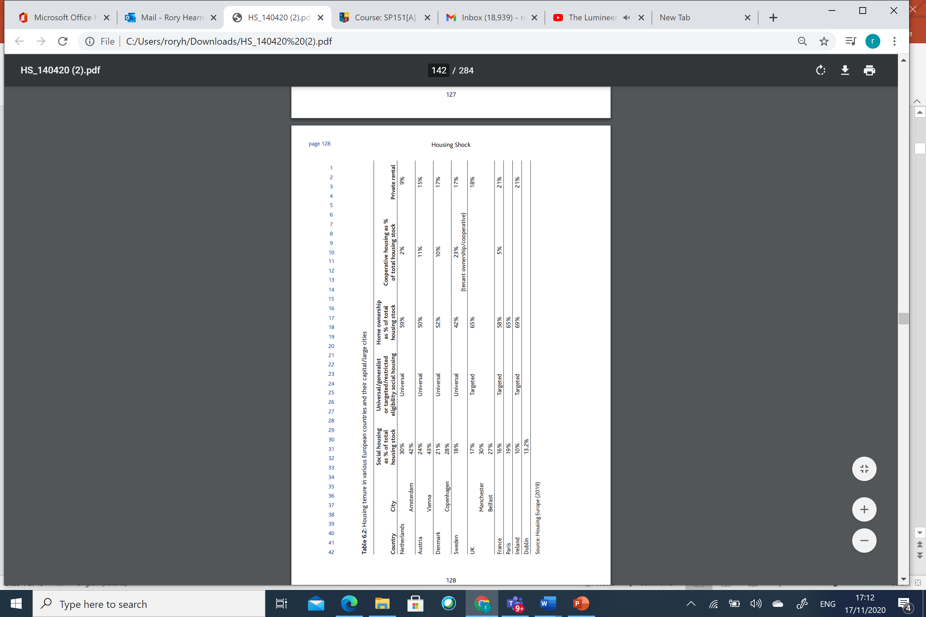
Ireland’s housing system in comparative perspective – housing tenures

Slide 17
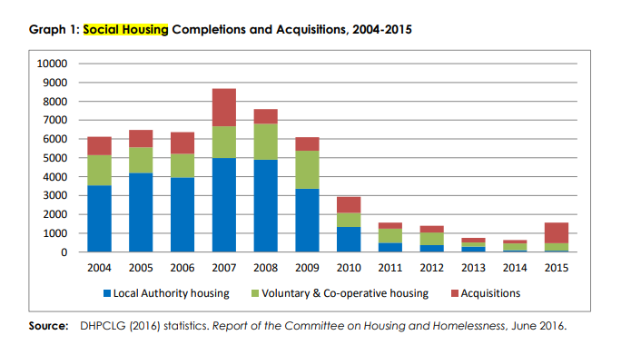
Phase 2. Austerity annihilation of social housing building –neoliberalism takeover

Slide 18
Social housing building in Ireland
Year | Local Authority housing |  |  |  | Voluntary & Co-operative housing¹
 | build ² | acquisitions ³ | Regeneration⁷ | Voids⁷ | CAS/CLSS completions
2004 | 3,539 | 971 |  |  | 1,607
2005 | 4,209 | 918 |  |  | 1,350
2006 | 3,968 | 1,153 |  |  | 1,240
2007 | 4,986 | 2,002 |  |  | 1,685
2008 | 4,905 | 787 |  |  | 1,896
2009 | 3,362 | 727 |  |  | 2,011
2010 | 1,328 | 850 |  |  | 753
2011 | 494 | 325 |  |  | 745
2012 | 363 | 351 |  |  | 677
2013 | 293 | 253 |  |  | 211
2014 | 102 | 183 |  |  | 357
2015 | 75 | 1,104 | 125 | 2,696 | 401
2016 | 320 | 54 | 230 | n/a
2017 | 1,014 | 70 | 690 | 523
2018 | 2,022 | 183 | 1,205 | 824
2019 | 2,271 | 142 | 2,033 | 1,325
2020 | 2,230 | 156 | 1,940 | 738
2021 | 1,998 | 141 | 2,144 | 913
2022 | 2,885 | 466 | 2,674 | 1,408

Slide 19
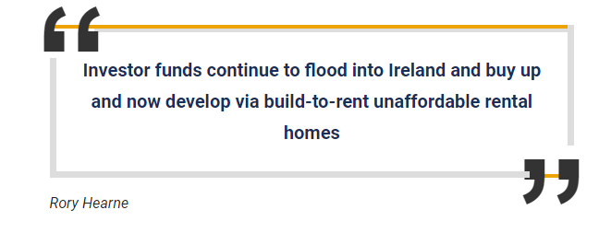
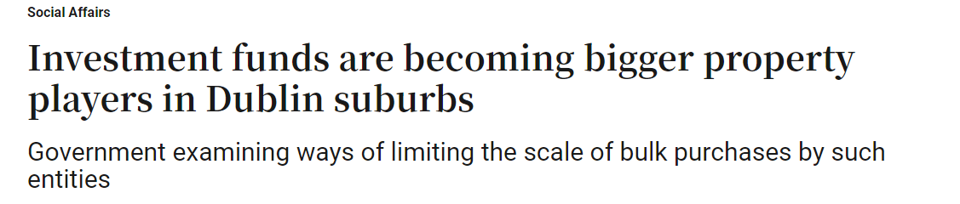
Financialization and commodification of housing: Dublin housing market taken over by non-household purchases –pushing up prices, blocking home purchases
September 2022
Of total 697 new build units in Dublin:
431 (62%) bought by ‘non-households’
January 2022-September 2022
Of total 4255 new build units in Dublin
2533 (60%) bought by ‘non-households’

Slide 20
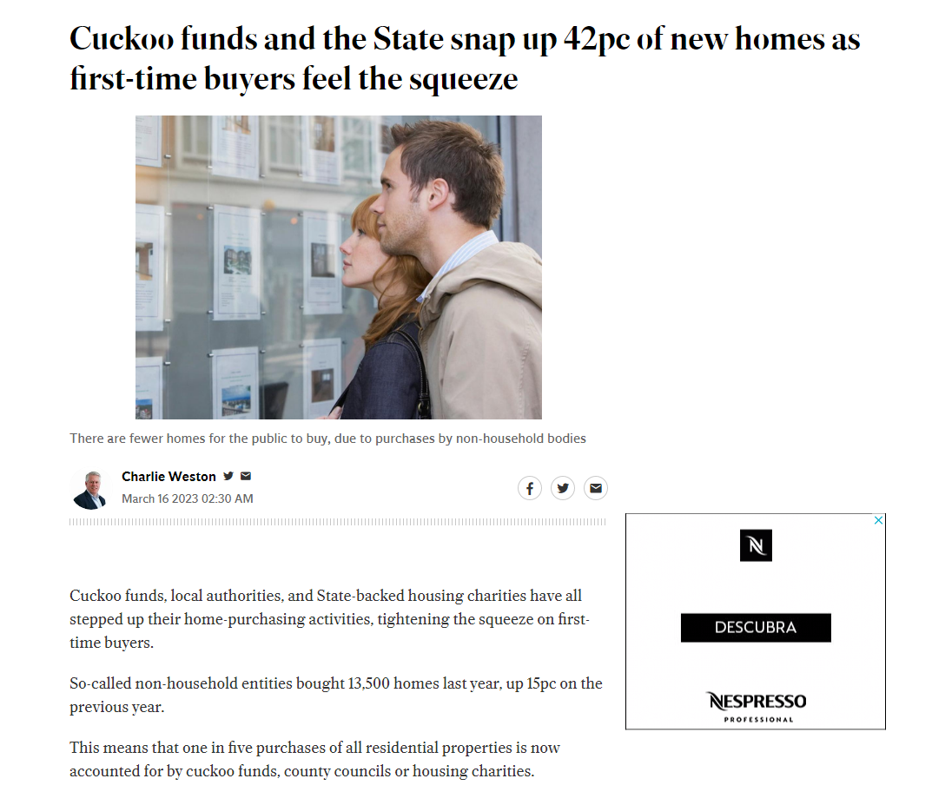
Cuckoo funds and the State snap up 42pc of new homes as first-time buyers feel the squeeze - Independent.ie

Slide 21
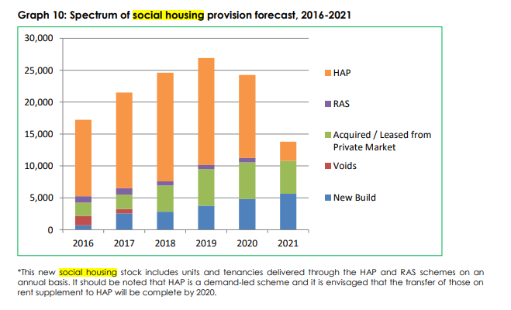

Embedding marketisation & financialisation of social housing – 2016 Rebuilding Ireland

Slide 22
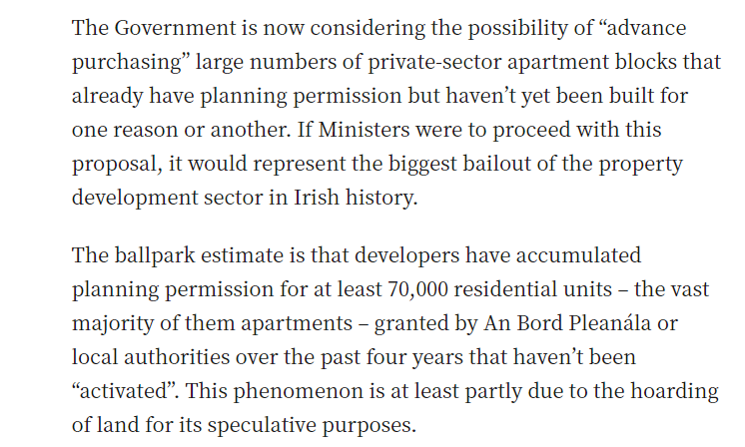
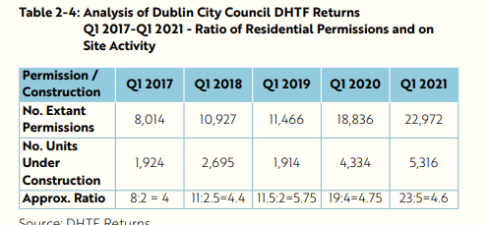
Speculative development – hoarding planning and waiting for prices and rents to rise – leading to rising rents and prices. Fall in construction of Build to Rent

Slide 23
Highlighting the scandal of vacant & derelict housing -Almost a decade of housing supply lies vacant
There are 166,752 vacant homes
Vacant dwellings are “habitable but unoccupied” meaning they can be lived in.
35,000 vacant rental properties, with just 851 properties advertised to rent nationally, is utterly unacceptable (How many are permanent Airbnb short stay tourist lets?)
Almost a third (48,387) of the vacant dwellings are long term vacant, being unused since 2016, and half of those, 23,483, are vacant for over a decade.
Cork city has 1,182 vacant rentals compared to 62 rental properties advertised on daft
Dublin City has 17,468 vacant dwellings, 5,198 of which are rentals.

Slide 24
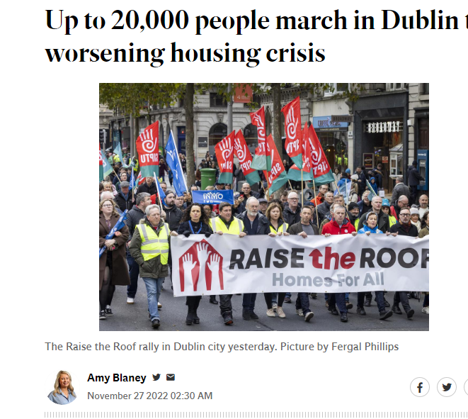
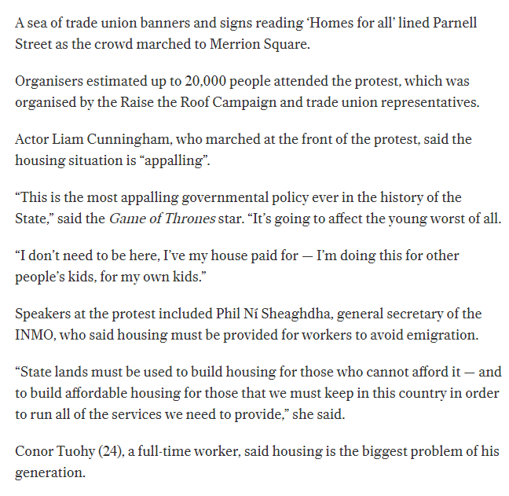
Raise the Roof

Slide 25
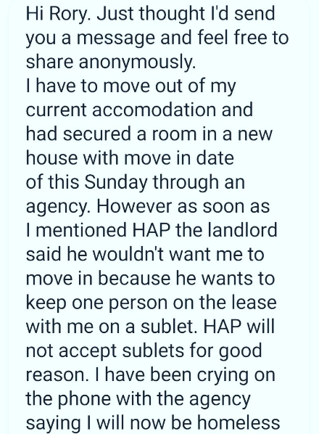
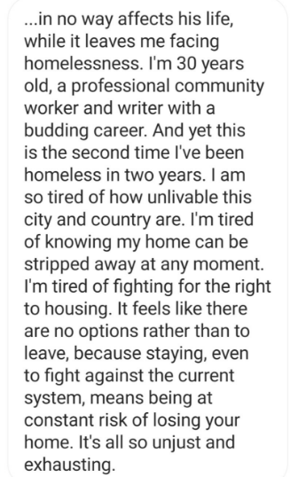
Supporting people to tell their story –publicly and sharing anonymously –daily contacting me

Slide 26
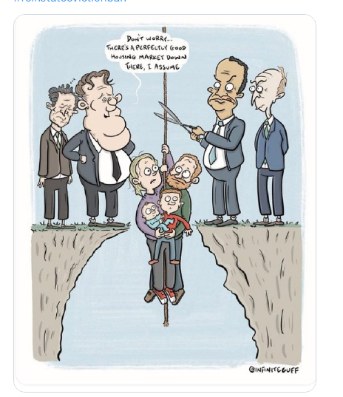

Slide 27
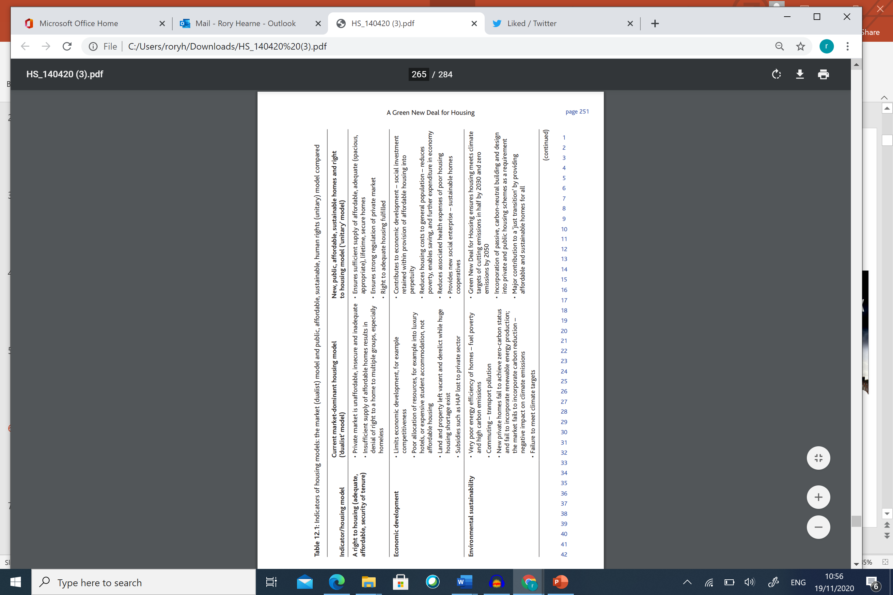
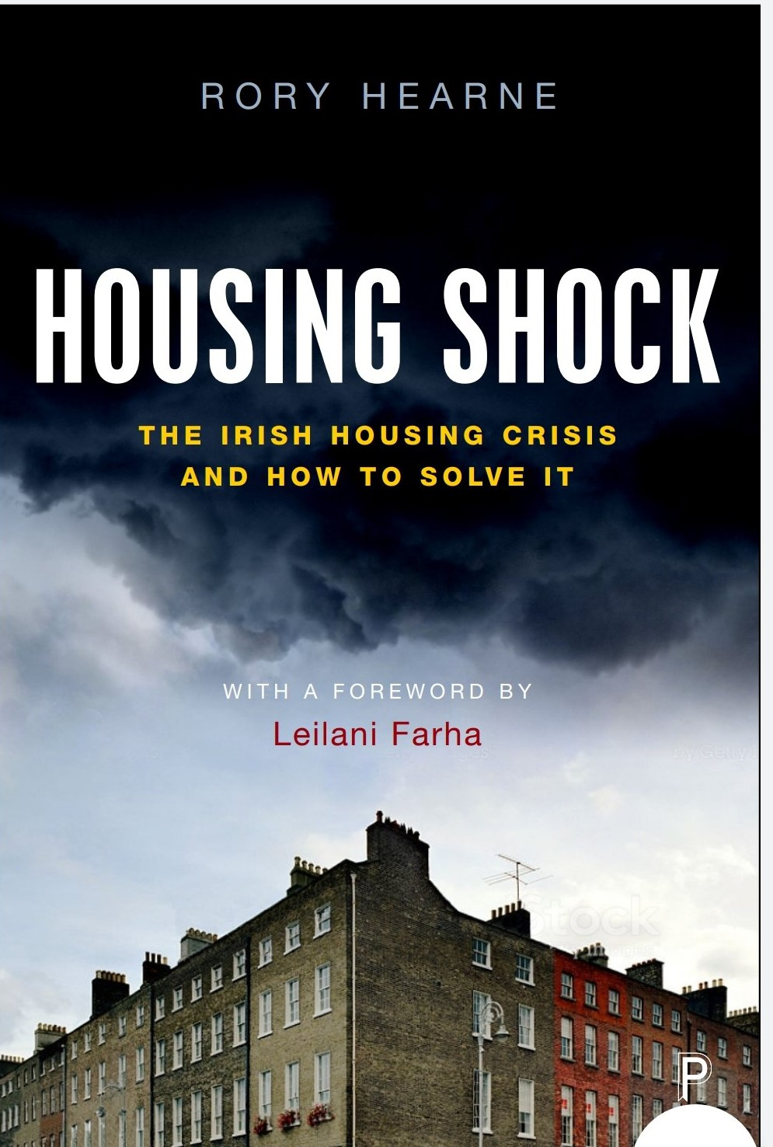
Or De-Financialisation through a new housing model – state & non-market led delivery of green affordable decent homes

Slide 28


Slide 29
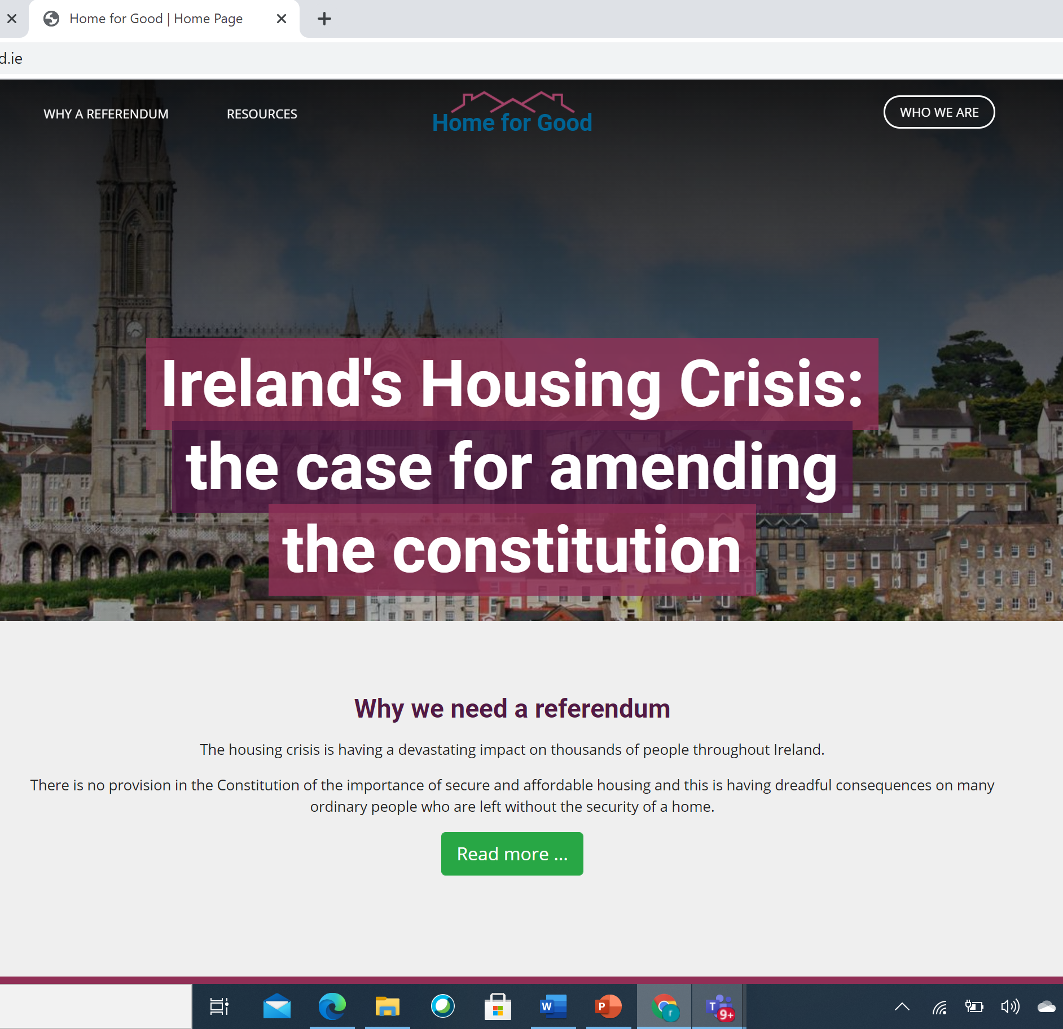
We need a Referendum:
The insertion of a new Article 43A on Housing in the Constitution as follows:
Article 43A
The State recognises, and shall vindicate, the right of all persons to have access to adequate housing.
The State shall, through legislative and other measures, provide for the realisation of this right within its available resources.

Slide 30
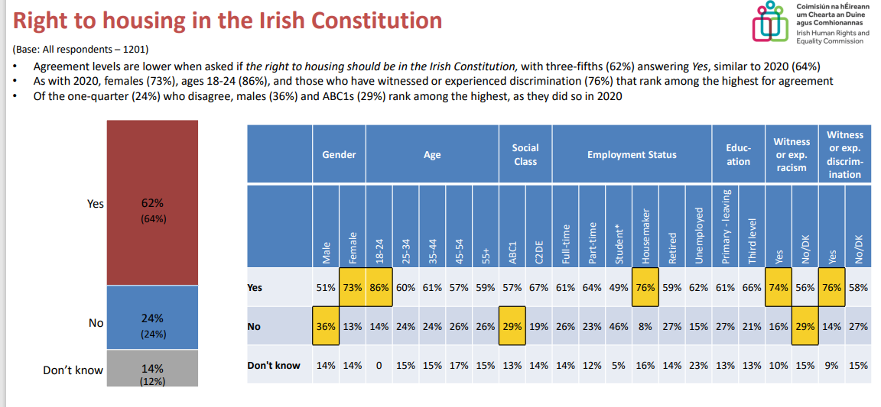
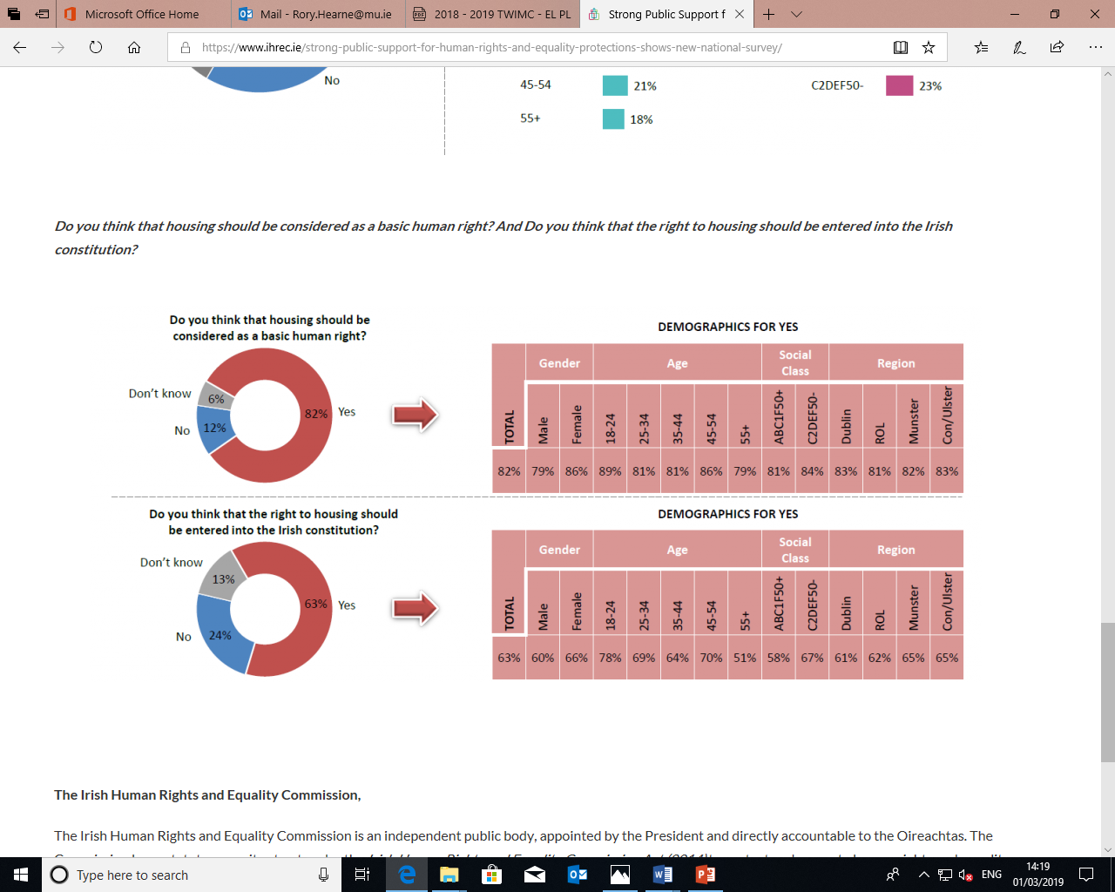
Current public opinion on Right to Housing

Slide 31
For housing & climate crises –the olds ways won’t work
Need new values and principles on which to design and build and deliver our urban spaces
Human need and planetary climatic need must be prioritised over private property investment and real estate profit
Major shift in who has power and decision making over our built environment.
The built environment must be reshaped and delivered to meet human need of home, community & environmental sustainability

Slide 32
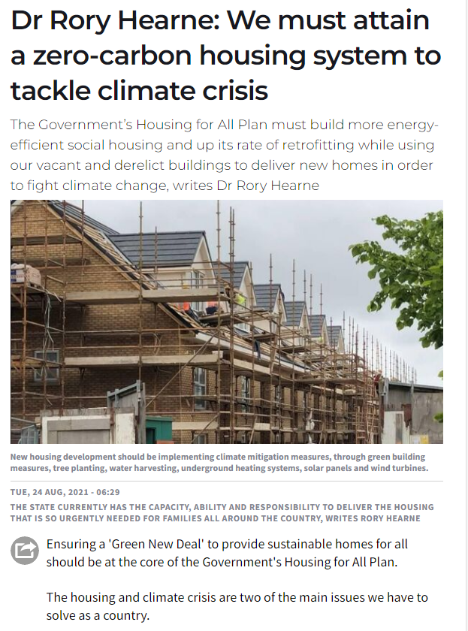
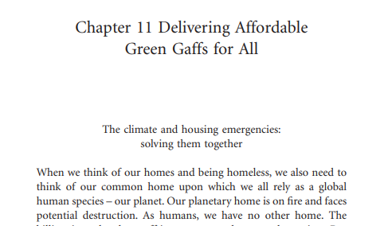
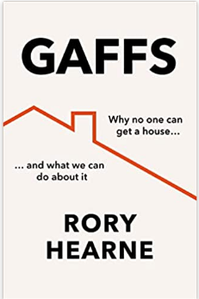
The future? A fundamental transformation in our understanding, funding & delivery of housing –affordable green homes for all

Slide 33
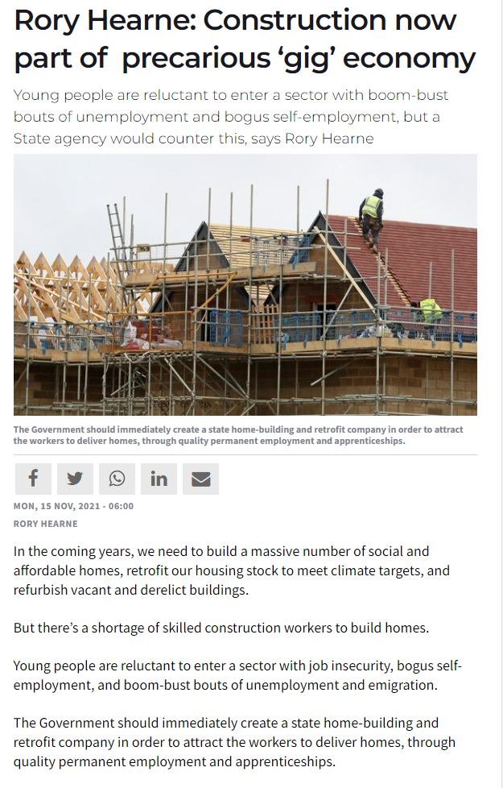
Solution: A state home and retrofit construction company
To guarantee delivery
Cost efficient
Provide decent jobs
The state employs 41,000 nurses and 64,000 teachers to guarantee delivery of quality public health and education.
Yet housing is even more fundamental to our lives than health or education. Without decent housing we have nothing, and the quality, design, and space of our homes, are also essential.
Yet there’s no such state employment to directly deliver housing.

Slide 34
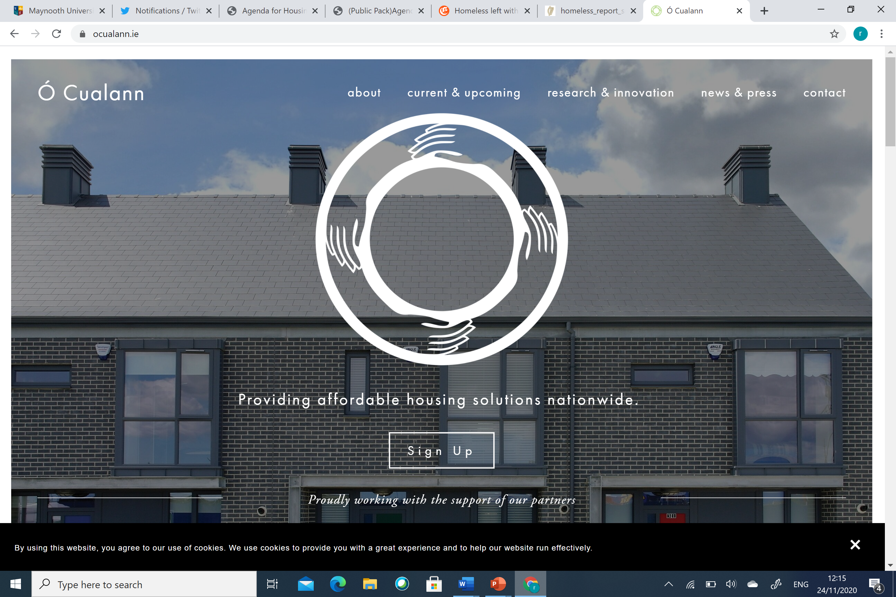
Local authorities, not-for-profit housing associations & cooperative housing model–vital role to play in housing delivery
A sustainable housing system requires more secure and diverse sources of supply
"We want to change the way housing is delivered in Ireland. Cooperative housing can play a major role in affordable housing delivery...we look to build communities & not just houses -we have a proud if almost forgotten history of cooperatives in Ireland“
Should be central to housing delivery

